Slide 1
Logistic regression

Slide 2

Logistic regression
Logistic Regression is used when the dependent variable(target) is categorical.
Email: Spam / Not Spam?
Online Transactions: Fraudulent (Yes / No)?
Tumor: Malignant / Benign ?
0: “Negative Class” (e.g., benign tumor)
1: “Positive Class” (e.g., malignant tumor)
The output from the hypothesis is the estimated probability.
This is used to infer how confident can predicted value be actual value when given an input X.
Notes:
https://diamondage.com/2017/06/03/what-does-it-mean-to-fit-a-model-anyway/

Slide 3
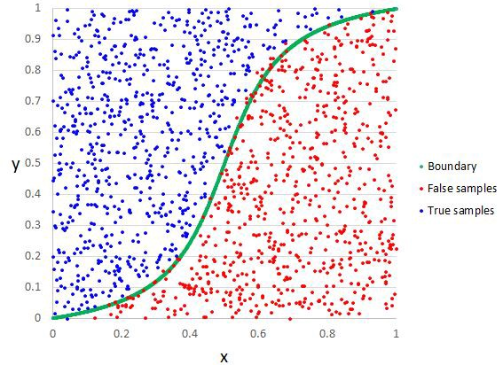
Logistic regression

Slide 4
Types of Logistic Regression
Binary Logistic Regression
The categorical response has only two 2 possible outcomes. Example: Spam or Not
Multinomial Logistic Regression
Three or more categories. Example: Predicting which food is preferred more (Veg, Non-Veg, Vegan)

Slide 5
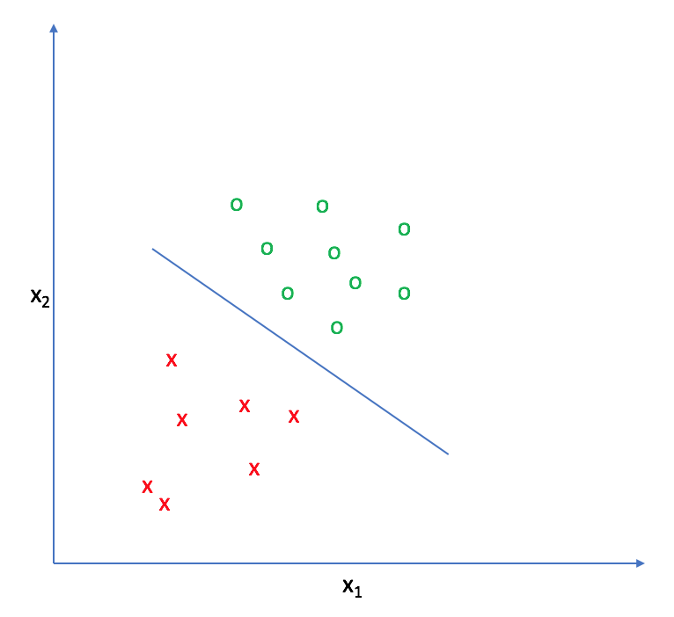
Decision Boundary
To predict which class a data belongs, a threshold can be set.
Based upon this threshold, the obtained estimated probability is classified into classes.

Slide 6
How does Logistic Regression work?
Logistic Regression assumes that the dependent variable follows a binomial distribution:
Each trial can have only two outcomes; i.e., the response variable can have only two unique categories.
The probability of success (p) and failure (q) should be the same for each trial.
For Linear Regression, we write the equation as:
`Y = βo + β1X + ∈`
In Logistic Regression, we use the same equation but with some modifications made to Y.
In Logistic Regression, we calculate probability of the class.

Slide 7
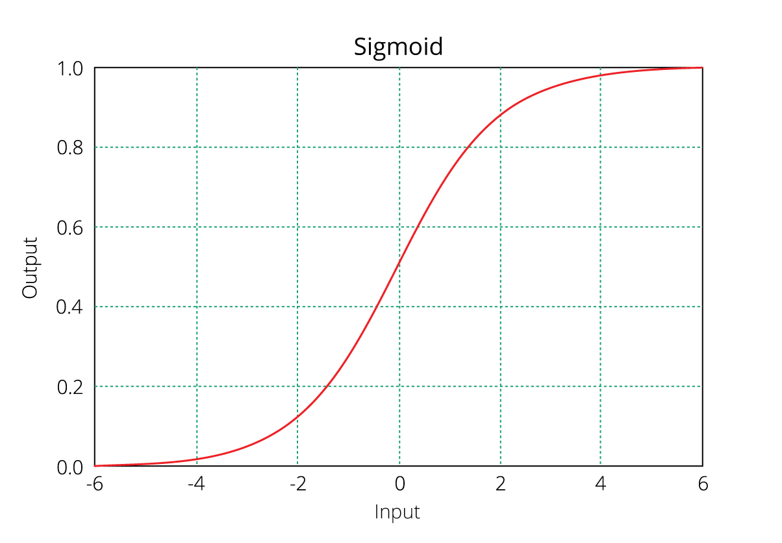
The Sigmoid Function
With the help of Sigmoid function, we transform the output from linear equation to the probability scale (0-1).

Slide 8
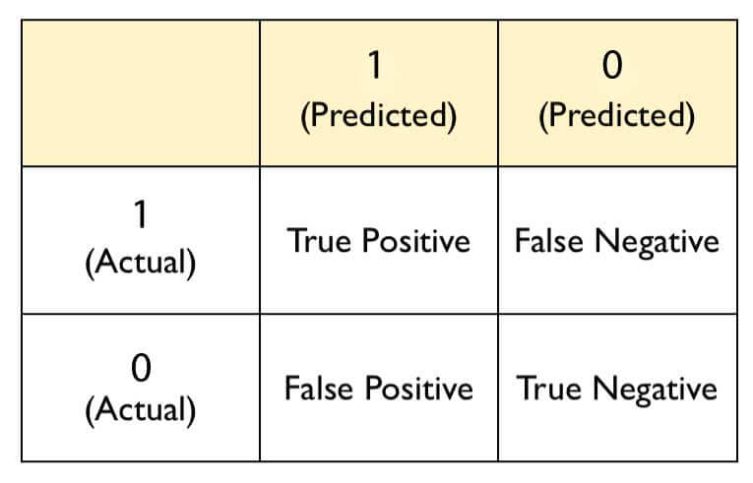
Confusion Matrix
Confusion matrix is commonly used to evaluate classification models.
It's quite confusing but make sure you understand it by heart.

Slide 9
Thanks

